Slide 1
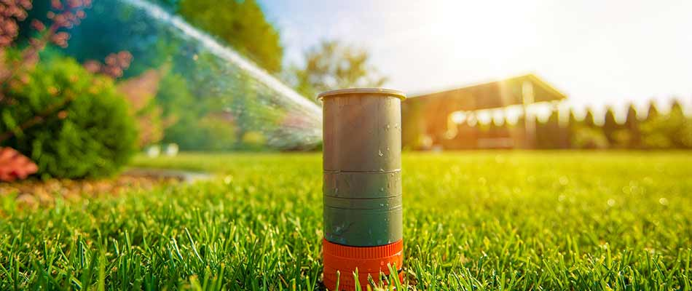
A
Project Presentation on
SMART IRRIGATION
SYSTEM
Submitted By:
Ankit Kumar Yadav(2101430109002)
Satyam Kumar(2001430100193)
Shivam Jaiswal (2101430109009)

Slide 2
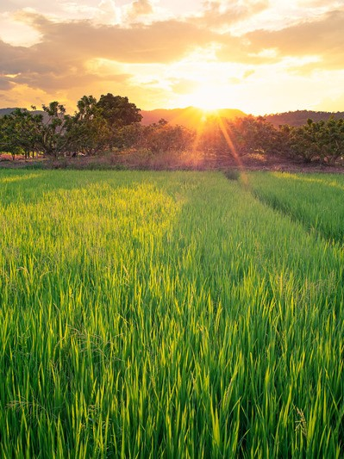

PROJECT DESCRIPTION OR
PROBLEM DEFINITION
At the current time, the world is facing a deficiency of water. Agriculture or planting is an occupation that is associated with the use of enough quantity of water. Irrigation mentions the activity of providing water to productive areas as a subsidiary of rainfall. Now there are many forms of irrigation systems that are taken on. The production of the irrigation system in conserve water is not noticeable. Further, the demand for water by the crops depends on the form of crops, soil, and all the environmental parameters such as temperature and wetness.

Slide 3
Objective/
AIM
It helps to grow agricultural crops, maintain landscapes, soil, consolidation and revegetate disturbed soils in dry areas and during periods of less than average rainfall. The objective of our project is to design an automated irrigation system which is cost effective and time saving using Node microcontroller.
Smart irrigation technology uses weather data or soil moisture data to determine the irrigation need of the landscape. Smart irrigation technology includes: These products maximize irrigation efficiency by reducing water waste, while maintaining plant health and quality.

Slide 4
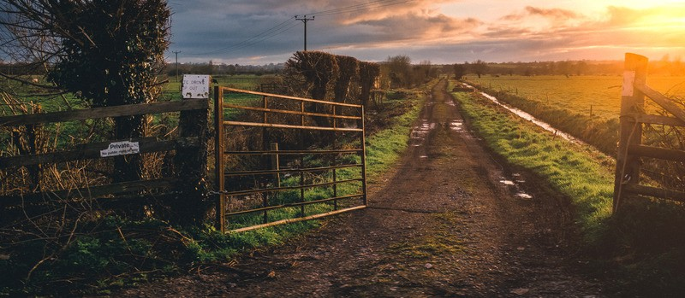

A G R I C U L T U R E
Wireless Sensor Network and Internet of Things (IoT) Solution in Agriculture This paper depicts the use of automated irrigation to promote water saving. RFID and WSN are utilised here, in addition to the ZigBee protocol. In this study, the role of human to human and human to machine is replaced by the Machine to Machine process. If the soil is dry, RFID based on the ZigBee Platform is used to send an ID to the reader, which then recognises the node.
Literature Survey
Then,
without human involvement, it delivers the correct value of data for irrigation procedures. The farmer can access the information via a system or a mobile device. Water may be sprinkled across the land at this location. When compared to manual watering, the automated irrigation approach can save up to 50% of the water .

Slide 5
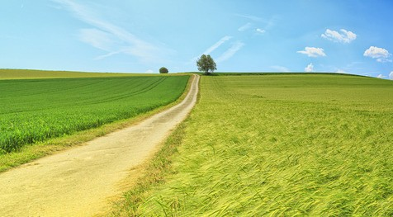


An IoT-based irrigation system is for effective agricultural management, allowing farmers to deal with issues. There are several IoT applications that solve key issues such as soil moisture detection, water conservation management, agricultural growth monitoring, and so on.
A G R I C U L T U R E
Through temperature, humidity, and other sensors networked to interact with the user, this technology offers better and smarter watering.
Methodology/
Planning of work
With the use of inexpensive, easy-to-install sensors and a plethora of insightful data, the Internet of Things has given incredibly productive ways for farmers and gardeners to nurture soil.
Water retained in the gaps between soil particles is referred to as soil moisture.

Slide 6
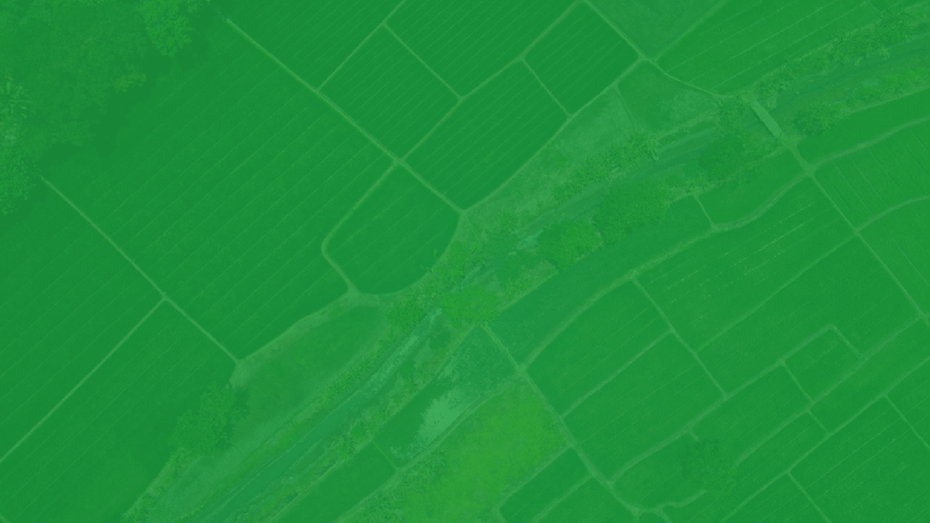


Technical details (Hardware and software requirements)
DHT11 sensor and LM 393 soil moisture sensor
Tensilica Xtensa 32-bit LX106 RISC microprocessor 5V and 200mA for routine running
Blynk Application
Arduino Integrated Development Environment

Slide 7
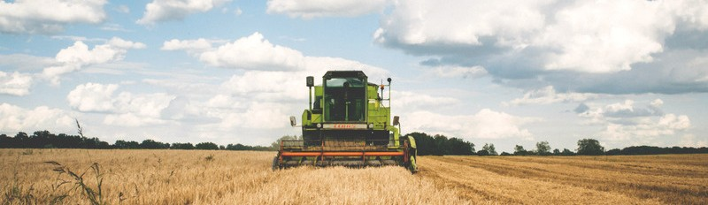


Innovativeness & Usefulness
Movement
Smart Irrigation systems save water, time, and money. Studies show that up to 50% of water usage for landscape irrigation can be saved with cloud-based Smart Irrigation systems. As a result, Smart systems typically pay for themselves in water savings within two years.

Slide 8
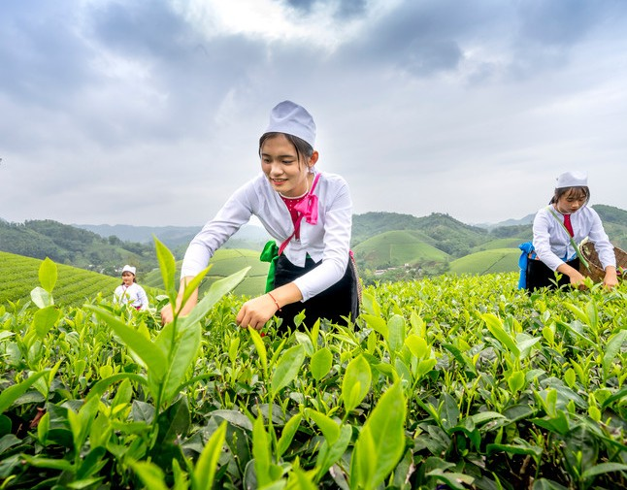
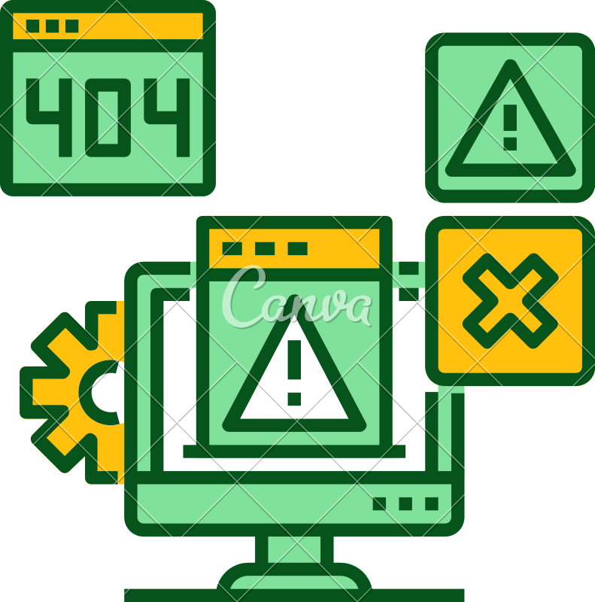

Market Potential & Competitive advantage
The fuzzy logic inference might be scaled out on a vast agricultural field to closely monitor the water requirements of up to 10 crop plants using only one irrigation device. Furthermore, because there will be more than one device on the field, they will be able to operate as nodes for data interchange between plants and integrate all data collected into a single packet for field analysis.
This paper may also be used to identify the soil profile and nutrient deficit in the soil or in a specific portion of the soil in order to measure crop production from the field.
This would allow a farmer, gardener, or simply a hobbyist to cultivate plants without ever getting their hands soiled.

Slide 9
thank you

